Slide 1

G2M Case Study
Virtual Internship
26-Feb-2023

Slide 2
Goal
XYZ is an American private equity company that intends to invest in the Cab industry due to the significant growth observed in recent years and the presence of several major players in the market. The goal is to offer practical guidance to assist XYZ in selecting the appropriate firm for investment purposes.
The analysis has been divided into four parts:
EDA
Making hypotheses
Testing them via making plots
Recommendations for investment

Slide 3
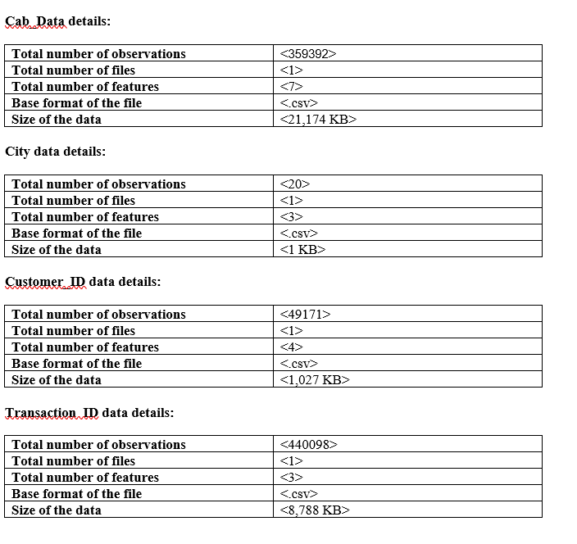
Data Exploration

Slide 4
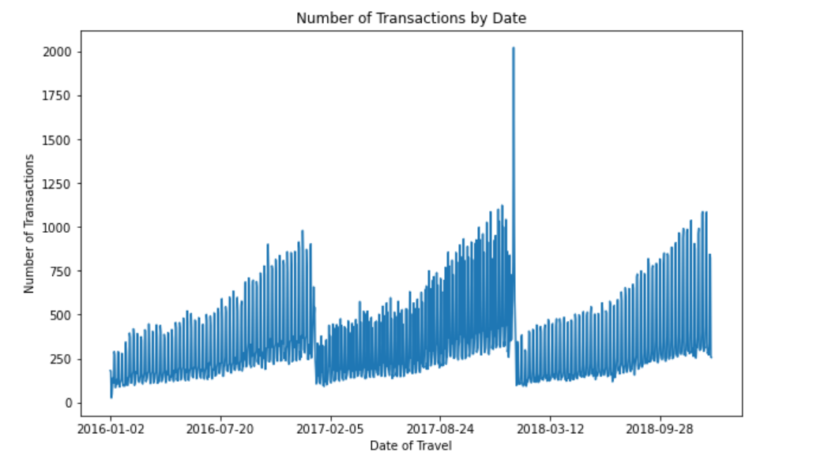
Seasonality Analysis
Seasonality Analysis

Slide 5
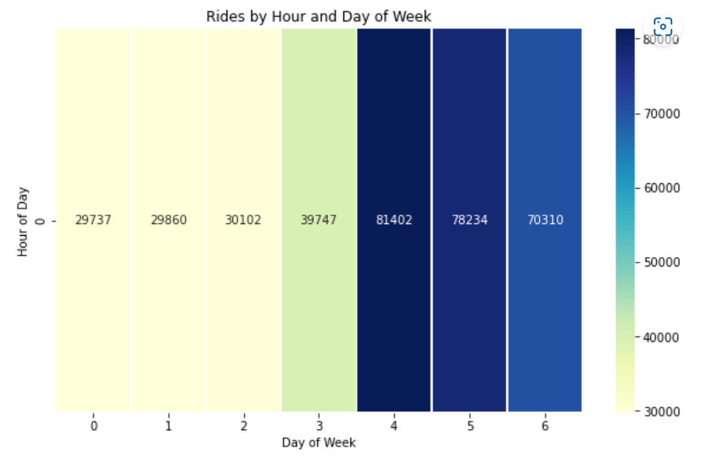
Is there more demand for cabs during weekend?

Slide 6
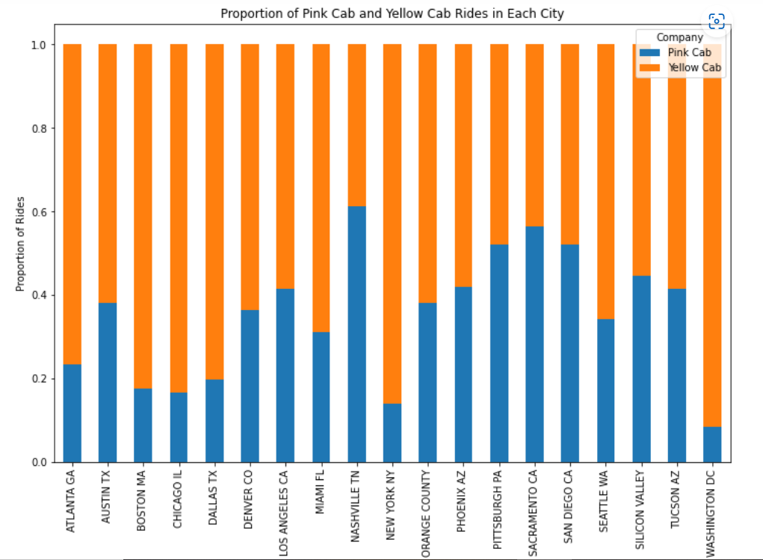
Is the proportion Yellow cab vs Pink cab usage same for all cities?

Slide 7
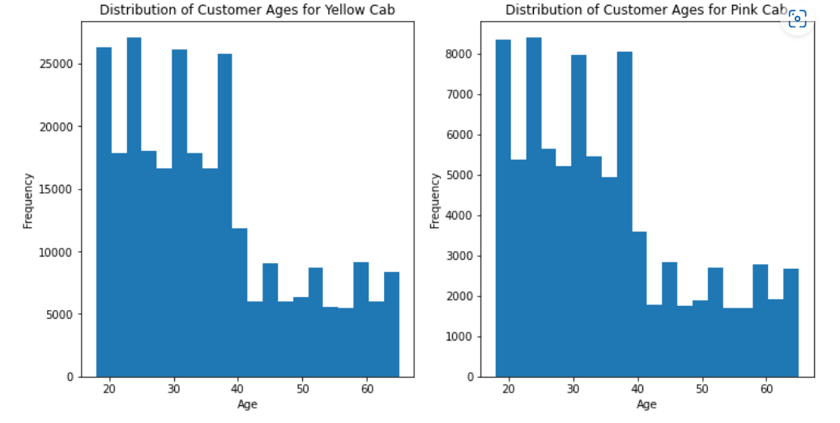
Do young people use cab more frequently?

Slide 8
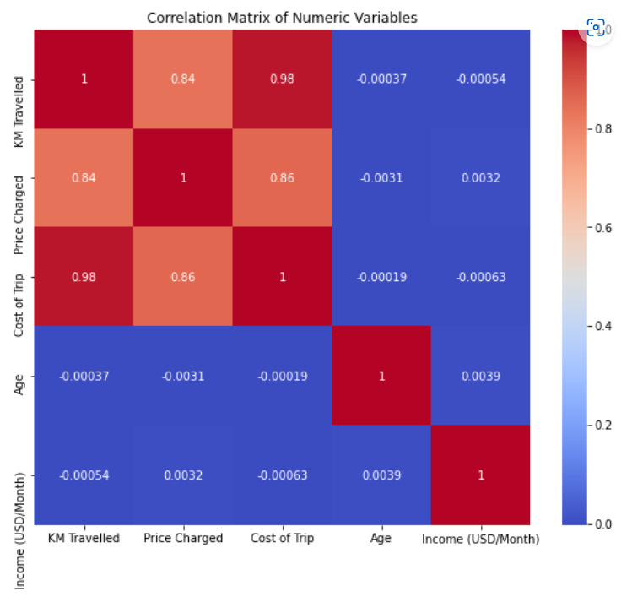
Do some of the variables have strong correlation?

Slide 9
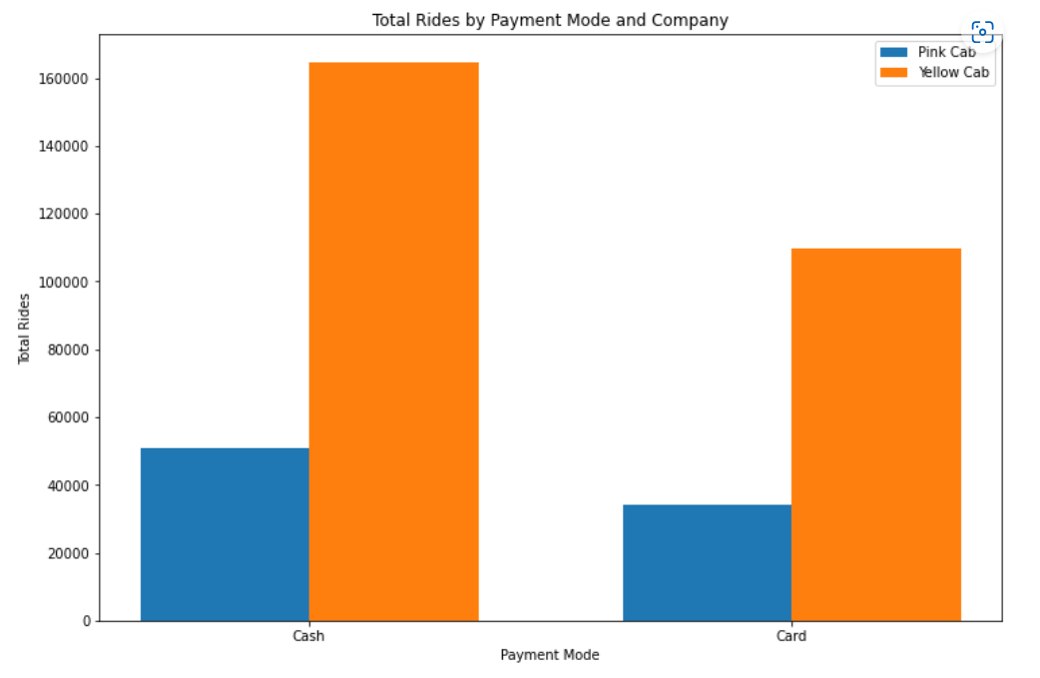
Do customers prefer card payments to cash?

Slide 10
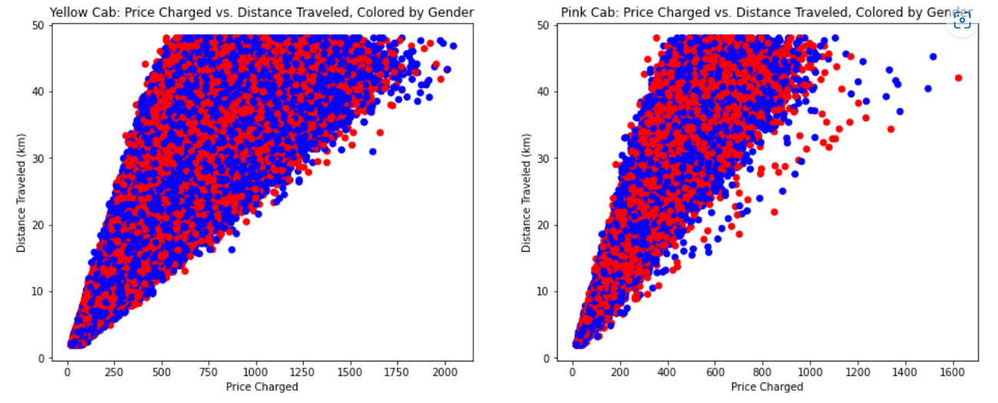
Is the relationship between distance travelled and price charged same for both companies?

Slide 11
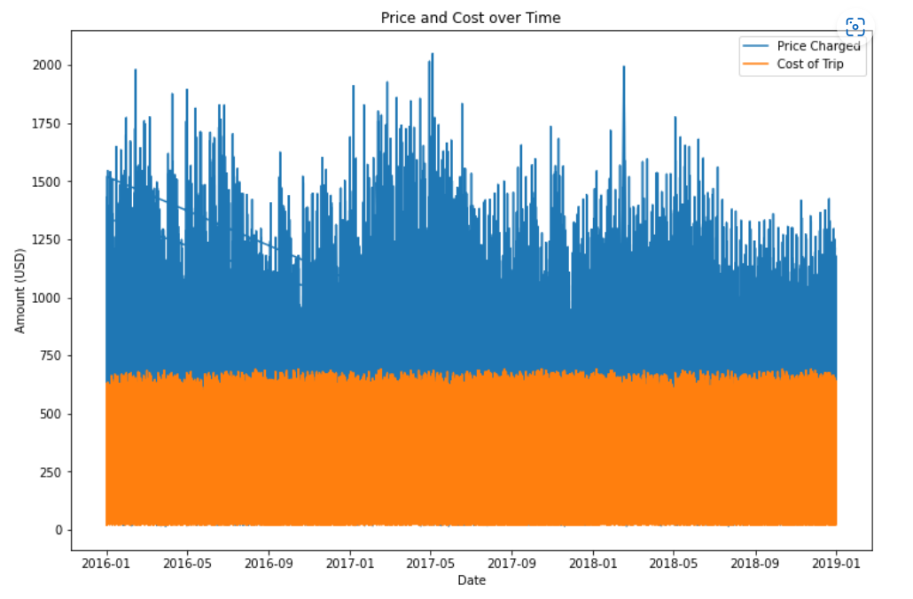
Is there a seasonality in price charged and cost of the trip?

Slide 12
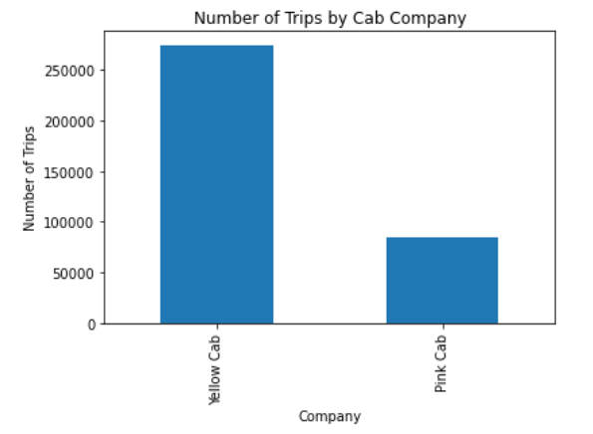
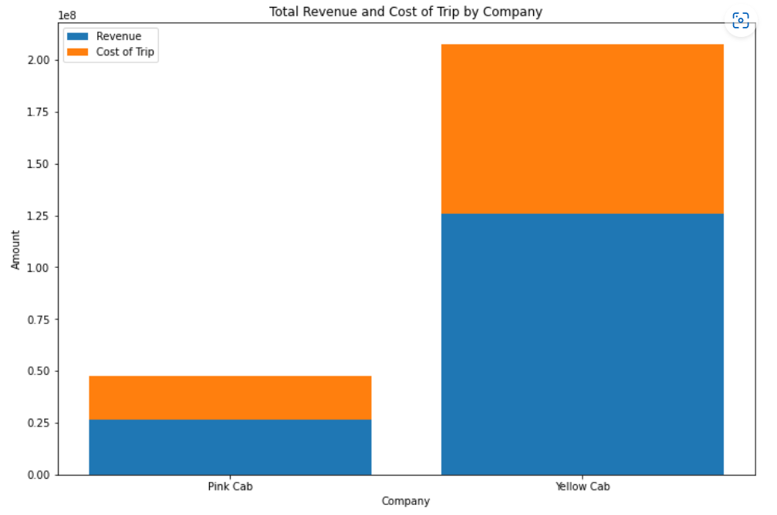
Revenue and Profit Comparison

Slide 13
Results
Yellow Cab makes 2.5 times more trips
Pink Cab has far more outliers. - their charging patterns vary widely
Younger people use cab more frequently in comparison to 40-60 y.o. customers
Nashville, Pittsburgh, Sacramento and San Diego are the only cities which prefers Pink Cabs more
Other 15 cities prefers Yellow Cabs(largest 6 cities included)
Customers prefer card payments to cash for both companies
Yellow Cab makes 2.5 times more revenue

Slide 14

Final recommendation
Yellow Cab, of course!

Slide 15
Thank You

